Slide 1


Next Gen - Apigee Platform Comparison

Slide 2
APIGEE Overview
Apigee is an API Management Platform , which develop, secure, publish, manage and monetize enterprise APIs.
Apigee API gateway , provides an abstraction for enterprise services or APIs and enables security, rate limiting, quotas, analytics, and more. Apigee API Developer Portal, provides a platform to publish and market API.
Features
Hosting
Form Factor
Other Google Services
Other Tool or Platform Integration
API Security & Traffic Management
API Design & Development
API Analytics
API Publishing
API Subscription
API Marketplace
API Monetization
Google Cloud Platform
On-Premise
Private Cloud (On AWS, Azure, etc.)
SaaS, managed by Apigee
Hybrid
Full Managed On-Prem
Cloud Armor for WAF
Cloud CDN for availability across globe
Cloud IAM for User identity
Cloud Monitoring and Logging services for metrics
Google GKE for Deployment
Anthos GKE for Deployment
Envoy Proxy with light weight API Gateway features
Connectors for Salesforce, AWS and GCP services

Slide 3
Apigee Product Variants
Apigee Edge SaaS
Apigee Edge OPDK
Apigee Hybrid
Apigee X
Apigee Envoy Adaptor
API Management platform hosted on GCP
Google Managed Infrastructure on GCP
Customer configures the platform and develops on cloud
All traffic routes through GCP clouds
Provides options to choose region for availability and Traffic Isolation packs
API Management platform hosted on Customer on-premise or private cloud
Customer Managed Infrastructure on-prem/private cloud
Customer configures the platform and develops on-premise/private cloud instance
All traffic routes through Customer infrastructure
Implemented in various topologies (5-node, 9-node, 13-node clusters) across data centers to achieve HA , performance and scalability
Build using new Product Architecture , where management plane is hosted on GCP and Runtime plane on Customer environment, as hybrid topology
Google managed infrastructure for management plane and Customer managed infrastructure for Apigee runtime
Customer configures the platform and develops on cloud , analytics data stored on GCP
All runtime traffic routes through Customer infrastructure
Supports multi-cloud topology for Runtime deployments
Uses Anthos GKE for managing workload for runtime hosted on Kubernetes clusters
Utilizes other GCP services for Identity , Logs and Analytics
Build using new Product Architecture , where Apigee manages runtime components in GCP
API Management platform hosted on GCP and infrastructure managed by Google
Customer VPC on GCP used to configure networking to access Apigee runtime hosted on Google managed VPC
Customer configures the platform and develops on cloud
All runtime traffic routes through GCP cloud ; availability across 24 regions using Cloud CDN
Multi-layer security provided by Cloud Armor and Google IAM
Automates Predictive analytics with Google AI services
Subset of API Management features for Security and Quota
API Management platform hosted on GCP
Envoy provides runtime proxy for API
Customer configures Envoy Adaptor and related components in its environment
All traffic routes through Envoy proxy

Slide 4
Apigee Products Components
Apigee Edge
Apigee Hybrid
Apigee X
Apigee Edge Component – Hosted on GCP for SaaS , or Customer On-prem/Private cloud for OPDK.
Management Components
Apigee Management UI
Management Server
Developer Portal
Runtime Components
Router
Message Processor
QPID
Postgres
Cassandra
Zookeeper
Management Plane – Hosted on GCP
Apigee Hybrid UI
Management Server
Unified Analytics Platform
Developer Portal
Runtime Plane – Hosted as Kubernetes Cluster on Customer managed multi-cloud(on-prem/private cloud)
Apigee Connect
Message Processor
MART
UDCA
Cassandra
Synchronizer
Istio Ingress/Envoy
Apigee X – Hosted on GCP
Components under Customer Managed Project on GCP
Apigee API Services
Developer Portal
L4 Internal Load balancer
VMs for Network bridge
Components under Google Managed Tenant Project on GCP
Apigee Runtime Services
L7 External Load balancer
Cloud NAT
Google Services
Cloud IAM
Cloud Identity
Cloud Monitoring
Cloud Logging
Google Projects
Google Services
Cloud IAM
Cloud Identity
Cloud Monitoring
Cloud Logging
Google Projects
Customer manages both management components and runtime components for OPDK installation of Apigee Edge
For SaaS, Customer only configures the platform and uses for implementation
Customer manages runtime components
Customer configures management platform, google services and use for implementation
Customer manages VPC on Google Cloud Platform
Customer configures networking components on VPC

Slide 5
Key Difference in Product Variants
Apigee Edge
Apigee Hybrid
Apigee X
Hosting Platform
SaaS - All Components hosted on GCP
OPDK – All Components hosted on Customer private cloud
Management Plane – Hosted on GCP
Runtime – Hosted on Customer multi-cloud(on-prem/private cloud)
All Component hosted on GCP
Infrastructure Ownership
SaaS - Managed by Google
OPDK – Managed by Customer
Google
* Networking configuration topology managed by Customer
Both Google and Customer
GCP Services
No Additional Google Services required
Require Google Services for IAM, Monitoring, etc.
Require Google Services for IAM, Monitoring, Networking, etc.
Support available for
Monetization
Micro-gateway
Node.js ,Hosted Targets, Extension
Apigee Sense
Support available for
Monetization
Cloud Armor
Google AI & ML services
Integrated Developer Portal
Support for Additional components
Support available for
Monetization
Integrated Developer Portal
Added responsibility on customer to manage external network configuration to access Apigee Runtime
Flexible to configure access per region
Flexibility to enable Cloud CDN to improve availability & performance globally
Configuration Addendum
All network configuration are within Apigee
Need additional tools for WAF, DDoS
Flexible to configure runtime closer to business applications, customized auto-scaling configuration per requirement

Slide 6
Product Variants Comparison – Detailed View
Feature | Apigee Edge | Apigee Hybrid | Apigee X
Hosting | SaaS – GCP hosted; OPDK – Customer on-prem/private cloud hosted | Management plan- Hosted in GCP Runtime Plan – Hosted on Customer private cloud | Both Management and Runtime Hosted on GCP
Ownership | SaaS - Managed by Google OPDK – Managed by Customer | Both Google and Customer Google manages Management Plane Customer manages Runtime Plane | Both Google and Customer Infrastructure managed by Google Network Configuration Topology managed by Customer
GCP Services | No Additional Google Services required | Require Google Services for IAM, Monitoring etc. | Require Google Services for IAM, Monitoring, Networking etc.
Management API | Yes | Yes, few management APIs deprecated related to KVM, Consumer apps, etc. Details on link at the bottom of table | Yes, few management APIs deprecated related to KVM, Consumer apps, etc. Details on link at the bottom of table
API Policies | All supported across SaaS and OPDK | Deprecated – OAuth 1.0 , StatisticsCollector New – DataCapture Policy, RevokeOauth2Policy | Deprecated – OAuth 1.0 , StatisticsCollector New – DataCapture Policy, RevokeOauth2Policy
KVM | Encrypted and non-encrypted, can be added by UI or Management API | Encrypted ; Cannot be added, updated from UI or Management APIs. Perform it from KeyValueMapOperations Policy | Encrypted ; Cannot be added, updated from UI or Management APIs. Perform it from KeyValueMapOperations Policy
Virtual Host | Yes | Not managed by Apigee, changed to environment group. Anthos Service Mesh manages ingress | Not managed by Apigee, changed to environment group. Each instance has its own https endpoint
API Proxies | No hard limit | Limited to 50 API Proxies per environment | Limited to 50 API proxies per environment
Node.js; Hosted targets | Yes | Not supported | Not Supported
For Detailed comparison , check below link
https://cloud.google.com/apigee/docs/api-platform/get-started/compare-apigee-products

Slide 7
Product Variants Comparison – Detailed View
Feature | Apigee Edge | Apigee Hybrid | Apigee X
Monetization | Yes | Yes, few features different from Apigee Edge | Yes; few features different from Apigee Edge
WAF/DDoS | Not available ; Customer WAF/DDoS Servers | Cloud Armor | Cloud Armor
User Identity | Local account or integrated with Customer IAM | Google IAM | Google IAM
Developer Portal | Integrated Developer Portal , Drupal 7 + based Developer Portal | Integrated Developer Portal , Drupal 8 based Developer Portal | Integrated Developer Portal , Drupal 8 based Developer Portal
AL/ML | Apigee Sense | Google AL and ML Services | Google AL And ML Services
Messaging Logging | Supported for file system logging | Support for File system Logging deprecated | Support for File system Logging deprecated
Alerts and Notifications | Configure and Managed within Apigee | Configure and Managed at GCP Monitoring Services | Configure and Managed by GCP Monitoring
Analytics | Real-time | Near Real-time; Asynchronous | Near Real-time; Asynchronous
Extensions | Supported | No support for Extensions | No support for Extensions
Certificates | Managed by Apigee | Not managed by Apigee ; Kubernetes cluster manages Certificates | Not Managed by Apigee; Envoy manages certificates and key
Open API Specification Store | Yes | No | No
For Detailed comparison , check below link
https://cloud.google.com/apigee/docs/api-platform/get-started/compare-apigee-products

Slide 8
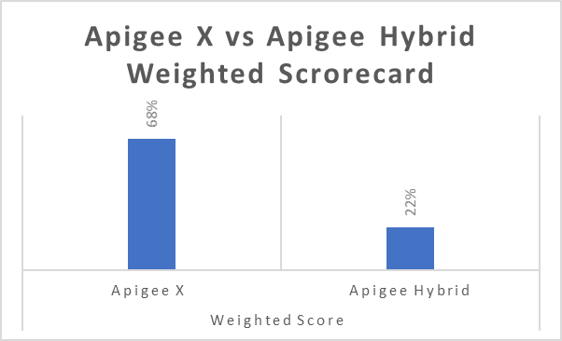
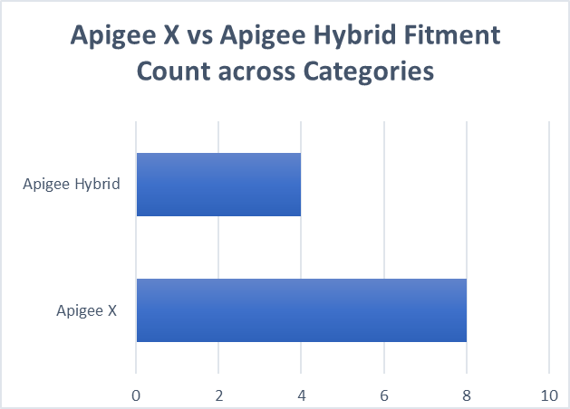
Framework/Scorecard for Apigee X vs Apigee Hybrid Fitment
A framework that captures user inputs/preferences on pre-defined evaluation criteria and weightage to each criteria
Customer can change the weightage of criteria and provide inputs as simple drop-down selection
The framework calculates the scorecard among 2 product variants based on given inputs and provides rationale for fitment
Representative Illustration of scorecard

Slide 9
Key Evaluation Criteria/Considerations
Deployment Topology (Multi-cloud/Single-cloud or datacenter )
API Traffic controls and compliance
Runtime Management and Ownership
Other Criteria such as
Availability
Scalability
Throughput
Complexity
Additional Skillset
Latency

Slide 10
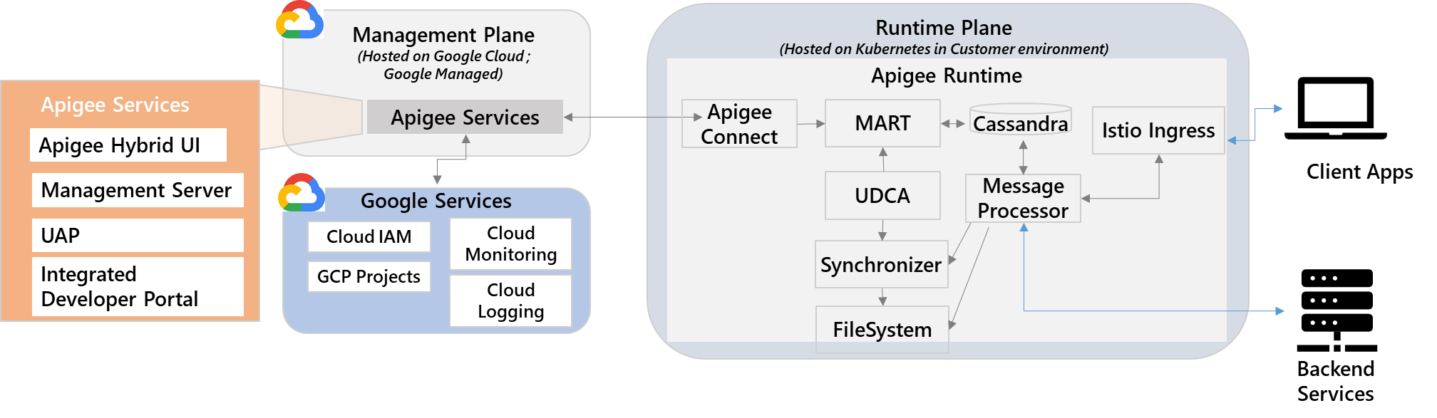
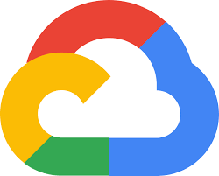
APIGEE Hybrid Overview & Architecture
Runtime Plane
Customer Hosted
Comprises of API traffic and runtime components
Interacts with Client apps & backend services or data
Management Plane
Google Hosted
Comprises of API Management, API deployment , development and marketplace
Interacts with Runtime for Analytics and syncing API deployments and runtimeconfig
Google Services
User Management & RBAC
Other Google services for platform management
Apigee Hybrid - Runtime Plane
Apigee Hybrid- Management Plane
Apigee Services
Apigee Hybrid UI – Create , configure API proxies, API products and Apps
Management Server- Manager Hybrid Organization and Environments
UAP – Unified Analytics Platform – Receives and processes analytics and deployment status data from runtime plane
Integrated Developer Portal - A light weight application developer portal
Google Cloud Services
Cloud IAM– Manage User access and roles for Apigee platform access
Cloud monitoring & logging – Receives data from Runtime plane to for monitoring & logging dashboard
GCP Projects- Contains resources used in Apigee Hybrid includes Org and environments
Apigee Connect – Agent which enables management plane to securely connect to MART
Message Processor – API request processing and policy execution
Cassandra – Persistent data store for entities such as KVM, Quota, OAuth, Response Cache and KMS
MART – An API server , which provide access to configuration, KMS , cache and KVM stored in Runtime plane datastore
UDCA(Universal Data Collection Agent)- Receives message processor trace , analytics and deployment status and send to UAP on Management Plane
Synchronizer - Fetch configuration data from management plane and propagates it across runtime plane components

Slide 11
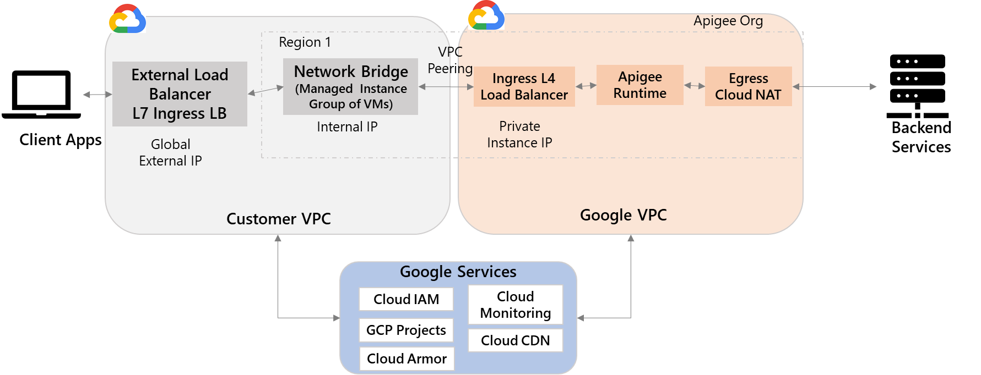
APIGEE X Overview & Architecture
Customer VPC
Customer managed GCP VPC, additional effort to manage customer VPC
Contains networking components for external client apps to access APIs
Integrates with Apigee X runtime hosted on Google VPC
Google VPC
Google managed VPC , host APIGEE X Runtime
Integrates with backend services and customer VPC for communication
No direct internet access from Client Apps available
Access Google Services for other configurations
Google Services
User Management & RBAC
Other Google services for platform management
Customer VPC
Google VPC
Per Apigee Organization
Ingress Load balancer – Ingress load balancer for Apigee runtime , communicate with network bridge on Customer VPC
Apigee Runtime – Core runtime of Apigee to process and execute API transactions
Egress Cloud NAT - Egress communication with backend services hosted on-premise or Internet
Google Cloud Services
Cloud IAM– Manage User access and roles for Apigee platform access
Cloud monitoring & logging – Receives data from Runtime plane to for monitoring & logging dashboard
GCP Projects- Contains resources used in Apigee X includes Org and environments
Cloud Armor - For additional WAF based security (optional)
Cloud CDN – For higher availability across regions (optional)
Google Services
External Load balancer– Load balancer to provide external IP for communication from Internet. Hosted using Google Loadbalancer service. This is a Global Load Balancer , all customer app access API using external Load balancer IP or DNS name
Network Bridge – A Managed instance group of VMs which are region specific to enable external LB to communicate with Apigee runtime hosted with Google VPC
VPC Peering - Customer VPC need VPC peering to communicate to Google VPC, cannot communicate directly

Slide 12
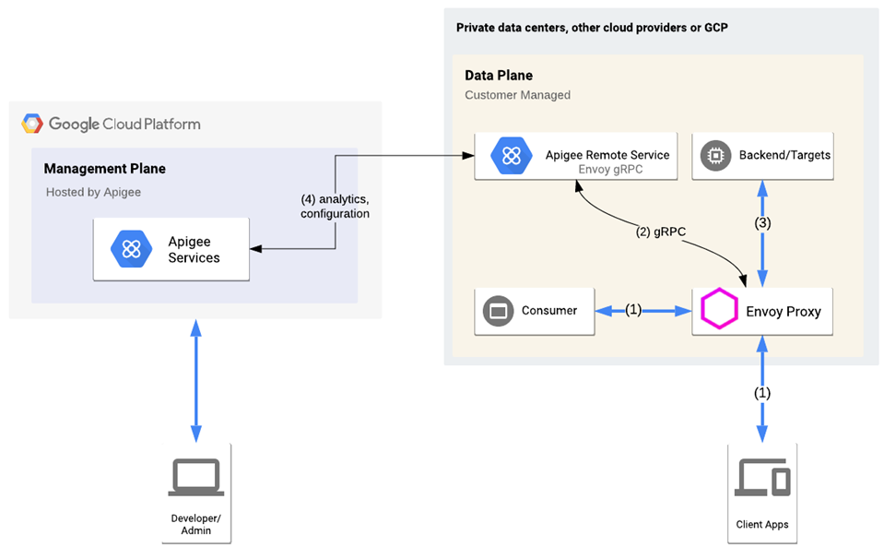
Apigee Adaptor for Envoy
A light-weight implementation of API Management platform where Apigee on GCP cloud provides security, traffic and analytics features and Envoy on customer on-premise/private cloud handles runtime for API proxy.
Key Features
Envoy Engine, acts as API proxy runtime which provides abstraction to backend services
Utilizes APIGEE Gateway on GCP Cloud to perform
Authentication
Quota
Analytics
Apigee Remote Service - Uses gRPC to communicate securely with Apigee Services on GCP
Deployment support for multi-cloud topology
Benefits
Deploy the runtime proxy engine closer to Client Apps
Manage Data within the realm of Customer infrastructure
Reduces latency for API transactions as it runs in close proximity to services
Reduces complexity to manage full feature set API Management platform
When to Use
Data for API traffic should remain within Customer infrastructure limits for compliance purpose
A subset of API Management feature require for API Proxy

